Slide 1
Color Theory and Perception
Strategy
Elizabeth Vinarski

Slide 2
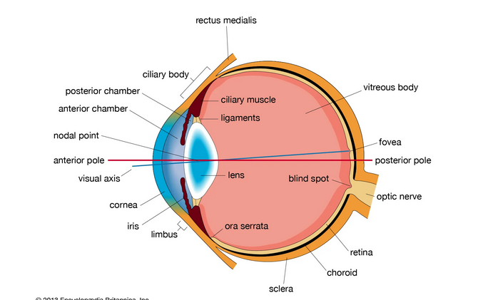
Background Information
Human retina contain over 100 million photoreceptors
Rods help us detect the differences between black and white (saturation levels)
Size and shape
Allow us to see in poorly lit conditions
Cones help us see color and details
3 groups, detect red light, green light, and blue light
Trichromatic theory of color vision – based on the activation of our primary cones
Computer images are created by pixels, mixing the colors blue, red, and green – additive colors
Notes:
Examples: seeing yellow, red and green cones are activated
When all three cones are equally activated, we see grayscale

Slide 3
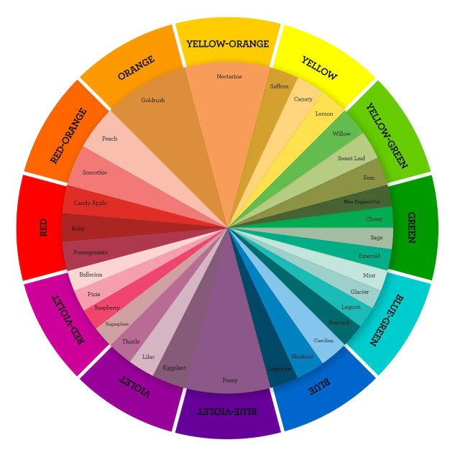
Color Wheel
Johann von Goethe, 19th century
Opponent process theory
3 receptors: blue-yellow, red-green, black-white
Only process one color at a time
Different colors in each pair have opposite effects on neurons, one signal being excitatory and one inhibitory

Slide 4
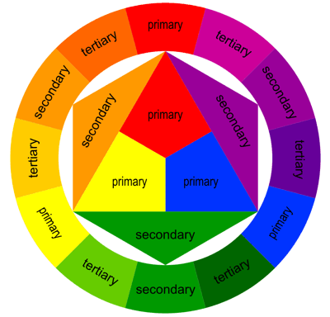
Some definitions of colors
Primary colors – red, blue, yellow
Secondary colors – mix the primary colors
Purple, green, orange
Tertiary colors – mix one primary color and one secondary color
Complementary – opposites
Triadic – three colors equally spaced
Square – 2 pairs, opposite from each other

Slide 5
Definitions
Hue – the actual color
Saturation – intensity/purity of a color (bright to gray)
Value – degree of lightness/darkness of hue (white to black)
Shade – produced by adding black
Tint – produced by adding white
Tone – produced by adding grey
Warm – colors with yellow undertones (left of the color wheel)
Cool – colors with blue undertones (right of the color wheel)
To photoshop!

Slide 6
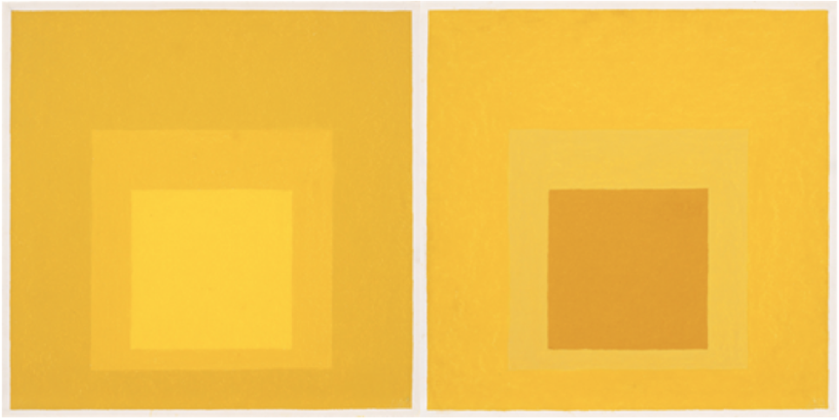
Is the background the same?
Notes:
Yes, it’s the same color.
Josef Albers, Homage to the Square – His point was that our perception of color as humans is astoundingly large, and even more so because it is subjective, and we interact with it and our environment

Slide 7
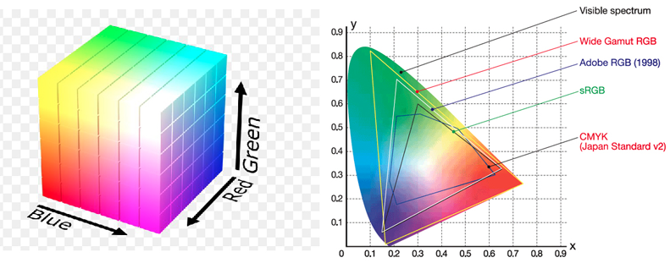
Somewhere Over The Rainbow
The rainbow color scheme became so popular because it uses very saturated hues that create high contrast in a data set. This is an example of a nonabsolute color space
Absolute colors spaces are defined by human perception, and since there is such a wide range of colors in our perception, we can actually mathematically represent color through coding, and graph these in a parabola.

Slide 8

Rainbow Troubles
Problems with the rainbow color scheme:
Can be misleading
Can wash out data sets
Cause color interference
Enhance certain data that are not special
Struggles scientists are having switching to anything else:
If someone has been working in a certain field their entire life, there are certain conventions and colors that infer certain things
Finding time to learn new color conventions

Slide 9
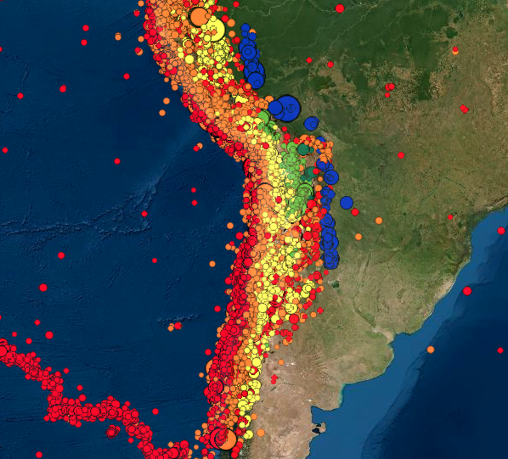


Slide 10
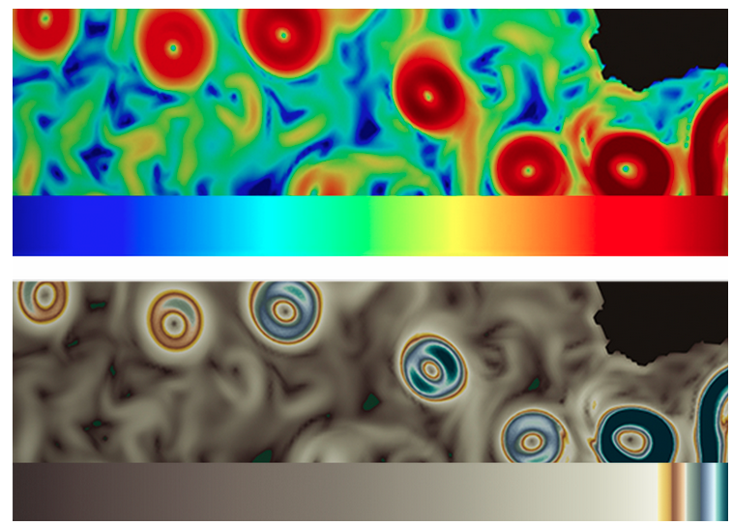
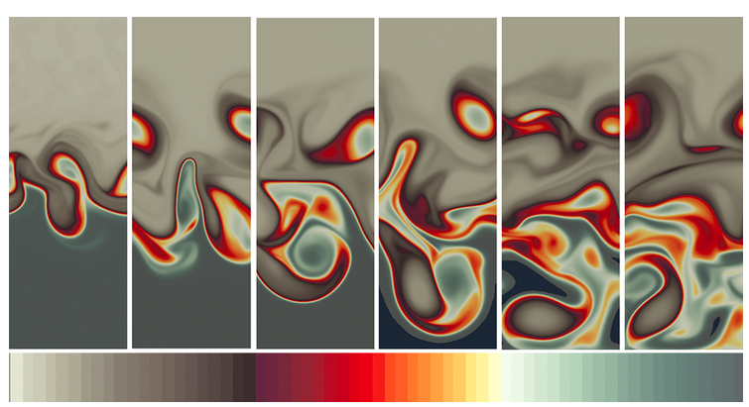
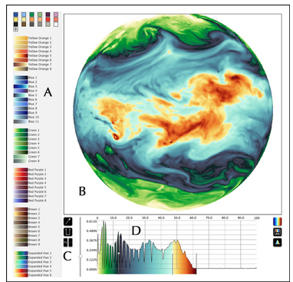
What should we do
Every data set is different
Each color scheme should be unique to its data set
Reflect the natural world
Use selective coloring to enhance certain data
Apps, personal designers
More research to be done

Slide 11
Extra Links
https://www.color-blindness.com/coblis-color-blindness-simulator/
safe or best-practices color bars https://colorbrewer2.org/#type=sequential&scheme=BuGn&n=3

Slide 12
Works Cited
https://caltechletters.org/science/color-perception
https://www.youtube.com/watch?v=L1CK9bE3H_s
https://www.youtube.com/watch?v=O8xryaE0-jE
https://towardsdatascience.com/8-rules-for-optimal-use-of-color-in-data-visualization-b283ae1fc1e2
https://uxplanet.org/analogous-colors-and-color-wheel-609a05b5b90e
https://blog.closetomyheart.com/2019/02/14/for-the-love-of-color-a-new-color-wheel/
https://eos.org/features/visualizing-science-how-color-determines-what-we-see
https://www.britannica.com/science/human-eye

